Slide 1


TESTING OF HYPOTHESIS
MATH 30
Probability and Statistics

Slide 2
OBJECTIVES
At the end of the lesson the students are expected to:
Define a statistical hypothesis
Create a Hypothesis from a given problem
Provide an alternative from the given hypothesis
Determine the errors in testing hypothesis
Identify the procedures for testing statistical hypothesis
Determine the appropriate test for testing hypothesis
Determine the appropriate level of significance
Interpret results from computed values

Slide 3
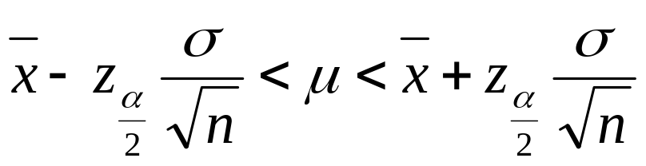

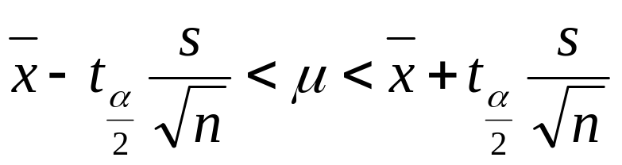

REVIEW
CONFIDENCE INTERVAL
Single Sample (Means)
Known Variance /Large Sample(n>30)
Large Sample (n>30):
Small Sample (n<30 and σ unknown)

Slide 4
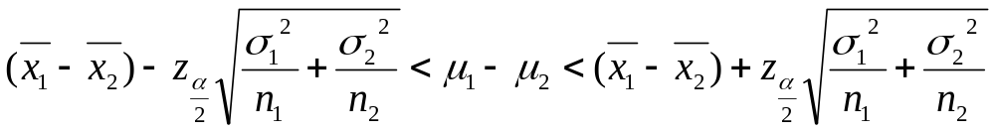
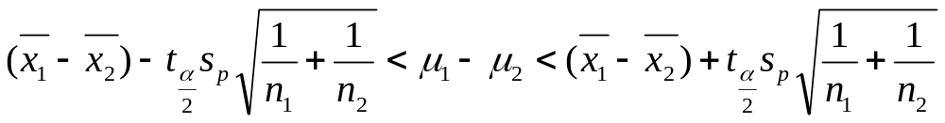

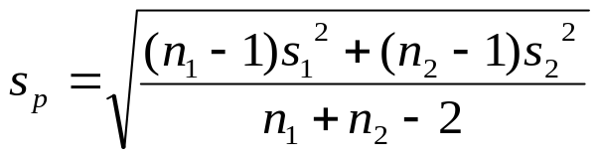
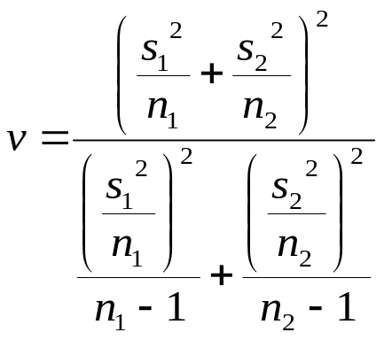
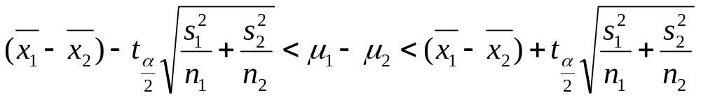
REVIEW
CONFIDENCE INTERVAL
Two Sample (Difference Between Two Means)
Known Variance /Large Sample(n>30)
Small Sample (Equal Variances)
Small Sample (Unequal Variances)

Slide 5
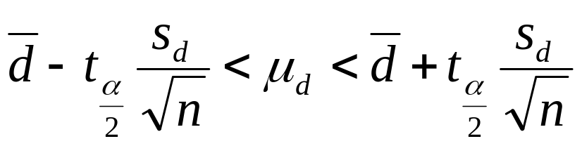
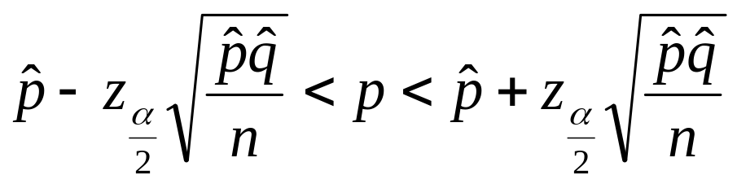
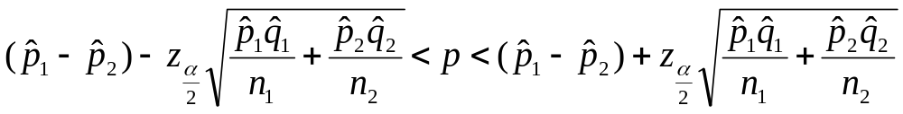
REVIEW
CONFIDENCE INTERVAL
Two Sample
Paired Observation
Proportion
Single Proportion
Difference of Two Proportions

Slide 6
REVIEW
CONFIDENCE INTERVAL
Two Sample
Paired Observation
Proportion
Single Proportion
Difference of Two Proportions

Slide 7
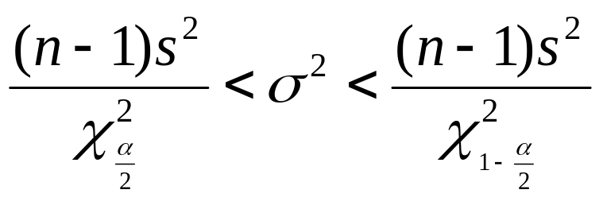
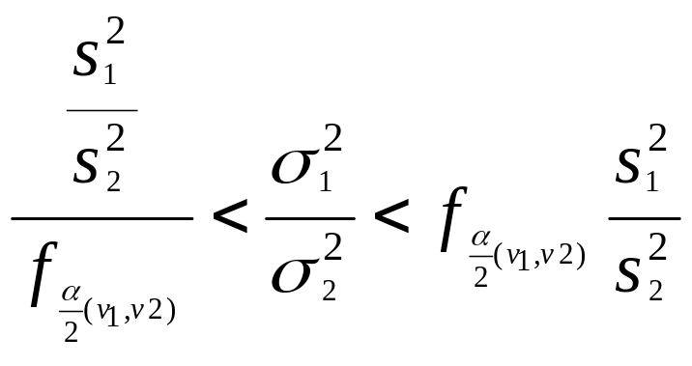
REVIEW
CONFIDENCE INTERVAL
Variances
Ratio of Two Variances

Slide 8
CONCEPTS
A statistical hypothesis test is a method of making decisions using data, whether from a controlled experiment or an observational study (not controlled).
A statistical hypothesis is an assertion or conjecture concerning one or more populations.
assumption/statement concerning one or more populations that may or may not be true
Results of Hypothesis Testing
statistically significant if it is unlikely to have occurred by chance alone, according to a pre-determined threshold probability, the significance level.
"Critical tests of this kind may be called tests of significance, and when such tests are available we may discover whether a second sample is or is not significantly different from the first.“ - Fisher

Slide 9
Basic Concepts
Types:
Null hypothesis (H₀)
statement about the value of the population parameter
must be stated with “equality” condition
2. Alternative Hypothesis (H₁)
the statement that holds true if H₀ is false
statement of inequality
The probability of rejecting the null hypothesis when
it is true is called the significance level (α).

Slide 10
Type I and Type II Errors
Decision | True state of nature
 | H₀ is true | H₀ is false
Reject the H₀ | Type I error | Correct decision
Fail to Reject H₀ | Correct decision | Type II error
Objective: minimize Type I error

Slide 11
Classical Method of Testing
Procedures in Statistical Testing of Hypothesis
Define H₀ and H₁.
Choose the level of significance (α)
Establish the critical region.
Select the appropriate test statistic
Make conclusion.
  A) Reject H₀ if test statistic has a value within
  the critical region
  B) otherwise, fail to reject H₀.

Slide 12
Classical Method of Testing
Defining Hypothesis:
Determine the Claim in the problem.
What parameter does the claim wants to check?
Does the claim include equality:
Keywords:
GREATER ( > ) LESS THAN ( < ) NOT EQUAL (≠)
Higher Lower Changed
Better Worsened Different
More Less Varied
Increased Decreased
GREATER THAN LESS THAN EQUAL (=)
OR EQUAL (>) OR EQUAL ( < )
At least At most the same
The same or better less or the same

Slide 13
Classical Method of Testing
Defining Hypothesis:
D. If the claim contains equality, it is the null hypothesis:
Η_{0 :} θ = θ_{α}
If the claim does not include equality, it is the alternative hypothesis.
Η_{1 :} θ > θ_{α} ; θ < θ_{α} ; θ ≠ θ_{α}
E. Negate or Contradict the hypothesis.

Slide 14
Classical Method of Testing
Level of Significance:
the probability of obtaining a type I error
the region where the population parameter does not fall in the confidence interval
Common Values of Statistical Significance ( α )
0.01 Highly Significant
0.05 Statistically Significant
0.10 Significant

Slide 15

Critical Region
Acceptance
region
1 - α
μ
Critical values
Rejection regions

Slide 16
Classical Method of Testing
Critical Region:
the probability of obtaining a type I error
the region where the population parameter does not fall in the confidence interval
Common Values of Statistical Significance ( α )
0.01 Highly Significant
0.05 Statistically Significant
0.10 Significant

Slide 17
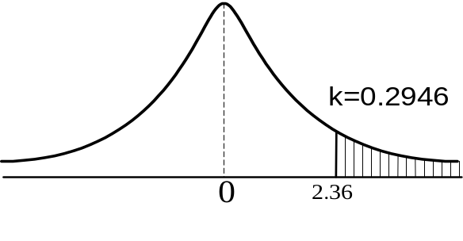
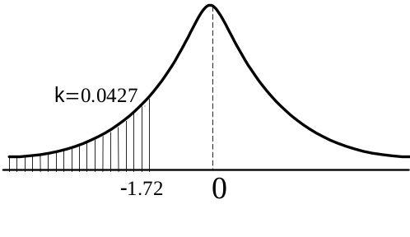
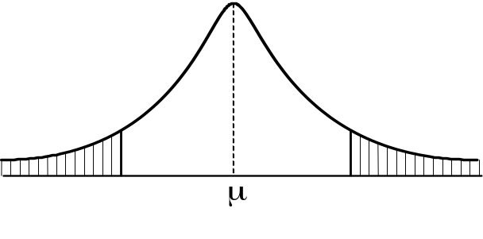
Classical Method of Testing
Critical Region:
Region where there is no sufficient proof to accept the null hypothesis, hence it is rejected and the alternative is accepted.
H₁: μ < μ_{o} H₁: μ > μ_{o}
H₁: μ ≠ μ_{o}

Slide 18
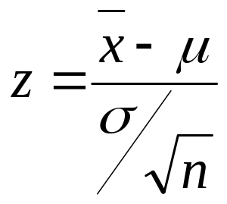
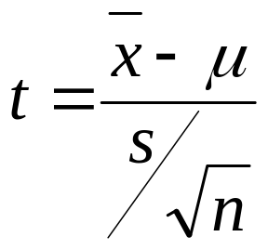
TEST STATISTICS
TESTING OF HYPOTHESIS
Single Sample (Means)
Known Variance /Large Sample(n>30)
Small Sample (n<30 and σ unknown)
H1: μ > μ_{ο} z > z_{α}
H1: μ < μ_{ο} z < z_{α}
H1: μ ≠ μ_{ο} z > z_{α/2 and} z < z_{α/2}
H1: μ > μ_{ο} t > t_{α}
H1: μ < μ_{ο} t < t_{α}
H1: μ ≠ μ_{ο} t > t_{α/2 and} t < t_{α/2}

Slide 19
EXAMPLES
Single Mean : Large Sample
In a labor management discussion it was asserted that it
takes the average worker 41.3 mins to get to work.
Usually, the travel time varies by 8.2 mins. A survey of
60 workers took on the average 39.7 mins to travel.
Using α = 0.01, determine if this agrees with the assertion.

Slide 20
EXAMPLES
# 5 page 300 Single Mean, Large Sample
It is claimed that an automobile is driven on the average more than 20 000 km per year. To test this claim, a random sample of 100 automobile owners are asked to keep a record of the kilometers they travel. Would you agree with this claim if the random sample showed an average of 23 500 km and a standard deviation of 3 900 km? Use 0.01 level of significance.

Slide 21
EXAMPLES
# 4 page 300 Single Mean, Large Sample
The average height of females in the freshman of a certain college has been 162.5 centimeters with a standard deviation of 6.9 centimeters. Is there a reason to believe that there has been a change in the average height if a random sample of 50 females in the present freshman class has an average height of 165.2 cm. Use 0.05 level of significance.

Slide 22
EXAMPLES
Single Mean : Small Sample
A random sample of 8 cigarettes of a certain brand has an
average nicotine content of 4.2 mg and a standard
deviation of 1.4 mg. Is this in line with the manufacturer’s
claim that the average nicotine content is less than
3.5 mg? Assume normality and α = 0.05

Slide 23
EXAMPLES
# 7 page 300 Single Mean, Small Sample
Test the hypothesis that the average content of containers of a particular lubricant is 10 L if the contents of a particular lubricant is 10 containers are 10.2, 9.7, 10.1, 9.8, 9.9, 10.4, 10.3 and 9.8 L. Use a 0.01 level of significance and assume that the contents is normal.

Slide 24
EXAMPLES
#10 page 300 Single Mean, Small Sample
Last year the employees of the city sanitation department donated an average of $10.00 to the volunteer rescue squad. Test the hypothesis at the 0.01 level of significance that the average contribution this year is still $10.00 if a random sample of 12 employees showed an average donation of $10.90 with a standard deviation of $1.75. Assume that the donations are normally distributed.

Slide 25
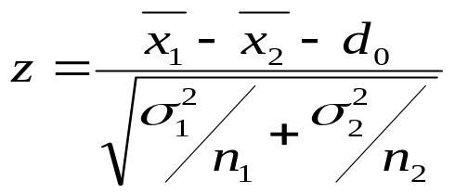
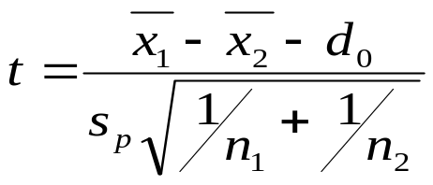

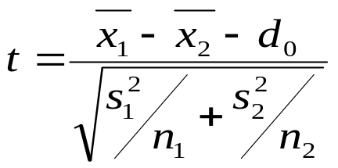
TEST STATISTICS
TESTING OF HYPOTHESIS
Two Means (Difference Between Two Means)
Known Variance /Large Sample(n>30)
Small Sample (n<30 and σ₁ = σ₂ and unknown)
Small Sample (n<30 and σ₁ ≠ σ₂ and unknown)
H1: μ ₁− μ₂ > d_{ο} z > z_{α}
H1: μ ₁− μ₂ < d_{ο} z < z_{α}
H1: μ ₁− μ₂ ≠ d_{ο } z > z_{α/2 and} z < z_{α/2}
H1: μ ₁− μ₂ > d_{ο} t > t_{α}
H1: μ ₁− μ₂ < d_{ο} t < t_{α}
H1: μ ₁− μ₂ ≠ d_{ο } t > t_{α/2 and} t < t_{α/2}
H1: μ ₁− μ₂ > d_{ο} t > t_{α}
H1: μ ₁− μ₂ < d_{ο} t < t_{α}
H1: μ ₁− μ₂ ≠ d_{ο } t > t_{α/2 and} t < t_{α/2}

Slide 26

EXAMPLES
A random sample of size n₁ = 25 taken from a normal
population with a standard deviation of σ₁ = 5 has a
mean x₁ = 80. A second random sample of size n₂=36
taken from a different normal population with a
standard deviation σ₂= 3, has a mean x₂ = 75. Using
α = .05, test the hypothesis that .

Slide 27
EXAMPLES
#12 page 330 Difference of Two Means, Large Sample
A random sample of size n₁ = 25, taken from a normal population with a standard deviation of ₁= 5.2, has a mean = 81. A second random sample size n₂ = 36, taken from different a normal population with a standard deviation of ₂= 3.4, has a mean = 76. Test the hypothesis that against the alternative . Use 0.05 level of significance.

Slide 28
EXAMPLES
#13 page 330 Difference of Two Means, Large Sample
A manufacturer claims that the average tensile strength of thread A exceeds the average tensile strength of thread B by at least 12 kg. To test his claim, 50 pieces of each type of thread had an average tensile strength of 86.7 kg with a standard deviation of 6.28 kg, while type B thread had an average tensile strength of 77.8 kg with a standard deviation of 5.61 kg. Test the manufacturer’s claim using a 0.05 level of significance.

Slide 29
EXAMPLES
#15 page 331 Difference of two means, Small Sample Equal Variances
A study is made to see if increasing the substrate concentration has an appreciable effect on the velocity of the chemical reaction. With a substrate concentration of 1.5 moles per liter, the reaction was run 15 times with an average velocity of 7.5 micromoles per 30 minutes with a standard deviation 1.5. With a substrate concentration of 2.0 moles per liter, 12 runs were made, yielding an average velocity of 8.8 micromoles per 30 minutes and a sample standard deviation of 1.2. Is there a reason to believe that this increase in substrate concentration causes an increase in the mean velocity by more than 0.5 micromole per 30 minutes? Use a 0.01 level of significance and assume the population to be approximately normally distributed with equal variances.

Slide 30
EXAMPLES
#17 page 331 Difference of two means, Small Sample Equal Variances
To find out whether a new serum will arrest leukemia, 9 mice, which have all reached an advanced stage of the disease are selected. Five mice receive the treatment and 4 do not. The survival times, in years, from the time the experiment commenced are as follows:
Treatment 2.1 5.3 1.4 4.6 0.9
No Treatment 1.9 0.5 2.8 3.1
Test the hypothesis that the average running time of films produced by company 2 exceeds the average running time of films produced by company 1 by 10 minutes against the one sided alternative that the difference is more than 10 minutes. Use a 0.1 level of significance and assume the distributions of times to be approximately normal with unequal variances.
#18 page 331 Difference of two means, Small Sample Unequal Variances
A large automobile manufacturing company is trying to decide whether to purchase brand A or brand B tires for its new models. To help arrive at a decision an experiment is conducted using 12 of each brand. The tires are run until they wear out. The results are:
Brand A : x₁ = 37 900 km s₁ = 5100 km
Brand B : x₂ = 39 800 km s₁ = 5900 km
Test the hypothesis at the 0.05 level of significance that there is no difference in the 2 brands of tires. Assume the populations to be approximately normally distributed.
#27 page 333 Paired Observations
According to the article “Practice and Fatigue Effects on the Programming of a Coincident Timing Response,” published in the Journal of Human Movement Studies in 1976, practice under fatigued conditions distorts mechanisms which govern performance. An experiment was conducted using 15 college males who were trained to make a continuous horizontal right-to-left arm movement from a micro-switch to a barrier, knocking over the barrier coincident with the arrival of a clock sweephand to the 6 o’clock position. The absolute value of the difference between the time, in milliseconds, that it took to knock over the barrier and the tie for the sweephand to reach the 6 o’clock position (500 msec) was recorded. Each participant performed the task five times under pre fatigue and post fatigue conditions, and the sums of the absolute differences for the five performances were recorded as follows:
ATD Respondent Number
1 2 3 4 5 6 7 8 9 10 11 12 13 14 15
PreFTG 158 92 65 98 33 89 148 58 142 117 74 66 109 57 85
PostFTG 91 59 215 226 223 91 92 177 134 116 153 219 143 164 100 An increase in the mean absolute time differences when the task is performed under the postfatigue conditions would support the claim that practice under the fatigued conditions distorts mechanisms that govern performance. Assuming the populations to be normally distributed, test this claim at 5% significance.
#1 page 343 Single sample Test of Variance
The volume of containers of a particular lubricant is known to be normally distributed with a variance of 0.03 liter. Test the hypothesis that lubricant is known to be normally distributed with a variance of 0.03 liter. Test the hypothesis that against the alternative that for the random sample of 10 containers. Use a 0.01 level of significance.
#3 page 343 Single Sample Test of Variance
The nicotine content of a certain brand of cigarette is known to be normally distributed with a variance of 1.3 mg. Test the hypothesis that against the alternative that if a random sample of 8 of these cigarettes has a standard deviation of s =1.8. Use a 0.05 level of significance
#5 page 343 Single Sample Test of Variance
A soft-drink dispensing machine is said to be out of control if the variance of the contents exceeds 1.15 deciliters. If a random sample of 25 drinks from this machine has a variance of 2.03 deciliters, does this indicate at the 0.05 level of significance that the machine is out of control? Assume that the contents are approximately normally distributed.
#7 page 343 Two sample test concerning Ratio of variances
A study is conducted to compare the length of time between men and women to assemble a certain product. Past experience indicates that the distribution of times for both men and women is approximately normally distributed but the variance of the times for women is less than that of men. A random sample of times for 11 men and 14 women produced the following data:
Men Women
n 11 14
s 6.1 5.3
Test the hypothesis that against the alternative that . Use a 0.01 level of significance.
#12 page 344 Two Sample Ratio of Variances
The hydrocarbon emissions are known to have decreased dramatically during the 1980s. A study was conducted to compare the hydrocarbon emissions at idling speed, in parts per million (ppm), for automobiles of 1980 and 1990. Twenty cars of each year model were randomly selected and their hydrocarbon emission levels were recorded. The data:
1980 Models
141 359 247 940 882 494 306 210 105 880 200 223 188 940 241 190 300 435 241 380
1990 Models
140 160 20 20 223 60 20 95 360 70 220 400 217 58 235 380 200 175 85 65
Test the hypothesis that against the alternative that . Use a 0.1 level of significance.

Slide 31
EXAMPLES
#18 page 331 Difference of two means, Small Sample Unequal Variances
A large automobile manufacturing company is trying to decide whether to purchase brand A or brand B tires for its new models. To help arrive at a decision an experiment is conducted using 12 of each brand. The tires are run until they wear out. The results are:
Brand A : x₁ = 37 900 km s₁ = 5100 km
Brand B : x₂ = 39 800 km s₁ = 5900 km
Test the hypothesis at the 0.05 level of significance that there is no difference in the 2 brands of tires. Assume the populations to be approximately normally distributed.
#27 page 333 Paired Observations
According to the article “Practice and Fatigue Effects on the Programming of a Coincident Timing Response,” published in the Journal of Human Movement Studies in 1976, practice under fatigued conditions distorts mechanisms which govern performance. An experiment was conducted using 15 college males who were trained to make a continuous horizontal right-to-left arm movement from a micro-switch to a barrier, knocking over the barrier coincident with the arrival of a clock sweephand to the 6 o’clock position. The absolute value of the difference between the time, in milliseconds, that it took to knock over the barrier and the tie for the sweephand to reach the 6 o’clock position (500 msec) was recorded. Each participant performed the task five times under pre fatigue and post fatigue conditions, and the sums of the absolute differences for the five performances were recorded as follows:
ATD Respondent Number
1 2 3 4 5 6 7 8 9 10 11 12 13 14 15
PreFTG 158 92 65 98 33 89 148 58 142 117 74 66 109 57 85
PostFTG 91 59 215 226 223 91 92 177 134 116 153 219 143 164 100 An increase in the mean absolute time differences when the task is performed under the postfatigue conditions would support the claim that practice under the fatigued conditions distorts mechanisms that govern performance. Assuming the populations to be normally distributed, test this claim at 5% significance.
#1 page 343 Single sample Test of Variance
The volume of containers of a particular lubricant is known to be normally distributed with a variance of 0.03 liter. Test the hypothesis that lubricant is known to be normally distributed with a variance of 0.03 liter. Test the hypothesis that against the alternative that for the random sample of 10 containers. Use a 0.01 level of significance.
#3 page 343 Single Sample Test of Variance
The nicotine content of a certain brand of cigarette is known to be normally distributed with a variance of 1.3 mg. Test the hypothesis that against the alternative that if a random sample of 8 of these cigarettes has a standard deviation of s =1.8. Use a 0.05 level of significance
#5 page 343 Single Sample Test of Variance
A soft-drink dispensing machine is said to be out of control if the variance of the contents exceeds 1.15 deciliters. If a random sample of 25 drinks from this machine has a variance of 2.03 deciliters, does this indicate at the 0.05 level of significance that the machine is out of control? Assume that the contents are approximately normally distributed.
#7 page 343 Two sample test concerning Ratio of variances
A study is conducted to compare the length of time between men and women to assemble a certain product. Past experience indicates that the distribution of times for both men and women is approximately normally distributed but the variance of the times for women is less than that of men. A random sample of times for 11 men and 14 women produced the following data:
Men Women
n 11 14
s 6.1 5.3
Test the hypothesis that against the alternative that . Use a 0.01 level of significance.
#12 page 344 Two Sample Ratio of Variances
The hydrocarbon emissions are known to have decreased dramatically during the 1980s. A study was conducted to compare the hydrocarbon emissions at idling speed, in parts per million (ppm), for automobiles of 1980 and 1990. Twenty cars of each year model were randomly selected and their hydrocarbon emission levels were recorded. The data:
1980 Models
141 359 247 940 882 494 306 210 105 880 200 223 188 940 241 190 300 435 241 380
1990 Models
140 160 20 20 223 60 20 95 360 70 220 400 217 58 235 380 200 175 85 65
Test the hypothesis that against the alternative that . Use a 0.1 level of significance.

Slide 32
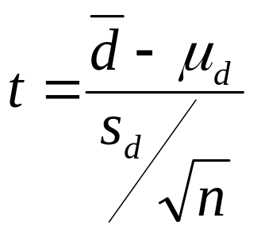
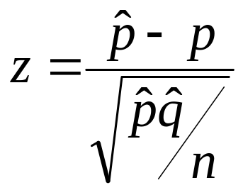
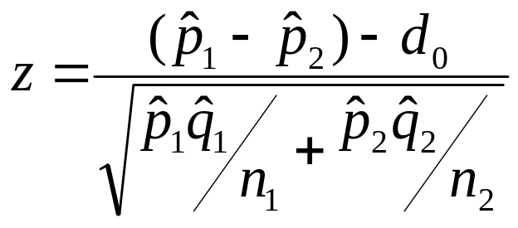
TEST STATISTICS
TESTING OF HYPOTHESIS
Two Sample – Paired Observation
Single Proportion
Difference of Proportions
H1: μ_{d} > μ_{ο} t > t_{α}
H1: μ _{d}< μ_{ο} t < t_{α}
H1: μ _{d}≠ μ_{ο} t > t_{α/2 and} t< t_{α/2}
H1:p > p_{ο} z > z_{α}
H1: p < p_{ο} z < z_{α}
H1: p ≠ p_{ο } z > z_{α/2 and} z < z_{α/2}
H1:p₁ -p₂ > p_{ο} z > z_{α}
H1: p₁ -p₂ > p_{ο} z < z_{α}
H1: p₁ -p₂ ≠ d_{ο } z > z_{α/2 and} z < z_{α/2}

Slide 33
EXAMPLES
#27 page 333 Paired Observations
According to the article “Practice and Fatigue Effects on the Programming of a Coincident Timing Response,” published in the Journal of Human Movement Studies in 1976, practice under fatigued conditions distorts mechanisms which govern performance. An experiment was conducted using 15 college males who were trained to make a continuous horizontal right-to-left arm movement from a micro-switch to a barrier, knocking over the barrier coincident with the arrival of a clock sweephand to the 6 o’clock position. The absolute value of the difference between the time, in milliseconds, that it took to knock over the barrier and the tie for the sweephand to reach the 6 o’clock position (500 msec) was recorded. Each participant performed the task five times under pre fatigue and post fatigue conditions, and the sums of the absolute differences for the five performances were recorded as follows:
ATD Respondent Number
1 2 3 4 5 6 7 8 9 10 11 12 13 14 15
PreFTG 158 92 65 98 33 89 148 58 142 117 74 66 109 57 85
PostFTG 91 59 215 226 223 91 92 177 134 116 153 219 143 164 100 An increase in the mean absolute time differences when the task is performed under the postfatigue conditions would support the claim that practice under the fatigued conditions distorts mechanisms that govern performance. Assuming the populations to be normally distributed, test this claim at 5% significance.
#1 page 343 Single sample Test of Variance
The volume of containers of a particular lubricant is known to be normally distributed with a variance of 0.03 liter. Test the hypothesis that lubricant is known to be normally distributed with a variance of 0.03 liter. Test the hypothesis that against the alternative that for the random sample of 10 containers. Use a 0.01 level of significance.
#3 page 343 Single Sample Test of Variance
The nicotine content of a certain brand of cigarette is known to be normally distributed with a variance of 1.3 mg. Test the hypothesis that against the alternative that if a random sample of 8 of these cigarettes has a standard deviation of s =1.8. Use a 0.05 level of significance
#5 page 343 Single Sample Test of Variance
A soft-drink dispensing machine is said to be out of control if the variance of the contents exceeds 1.15 deciliters. If a random sample of 25 drinks from this machine has a variance of 2.03 deciliters, does this indicate at the 0.05 level of significance that the machine is out of control? Assume that the contents are approximately normally distributed.
#7 page 343 Two sample test concerning Ratio of variances
A study is conducted to compare the length of time between men and women to assemble a certain product. Past experience indicates that the distribution of times for both men and women is approximately normally distributed but the variance of the times for women is less than that of men. A random sample of times for 11 men and 14 women produced the following data:
Men Women
n 11 14
s 6.1 5.3
Test the hypothesis that against the alternative that . Use a 0.01 level of significance.
#12 page 344 Two Sample Ratio of Variances
The hydrocarbon emissions are known to have decreased dramatically during the 1980s. A study was conducted to compare the hydrocarbon emissions at idling speed, in parts per million (ppm), for automobiles of 1980 and 1990. Twenty cars of each year model were randomly selected and their hydrocarbon emission levels were recorded. The data:
1980 Models
141 359 247 940 882 494 306 210 105 880 200 223 188 940 241 190 300 435 241 380
1990 Models
140 160 20 20 223 60 20 95 360 70 220 400 217 58 235 380 200 175 85 65
Test the hypothesis that against the alternative that . Use a 0.1 level of significance.

Slide 34
EXAMPLES
#27 page 333 Paired Observations
Cont:
ATD Respondent Number
1 2 3 4 5 6 7 8 9 10 11 12 13 14 15
PreFTG 158 92 65 98 33 89 148 58 142 117 74 66 109 57 85
PostFTG 91 59 215 226 223 91 92 177 134 116 153 219 143 164 100
An increase in the mean absolute time differences when the task is performed under the postfatigue conditions would support the claim that practice under the fatigued conditions distorts mechanisms that govern performance. Assuming the populations to be normally distributed, test this claim at 5% significance.

Slide 35
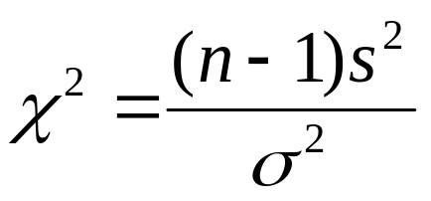
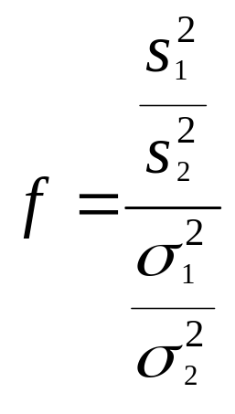
REVIEW
TEST OF HYPOTHESIS
Variances
Ratio of Two Variances
H1: σ > σ_{ο} z > z_{1−α}
H1: σ < σ_{ο} z < z_{α}
H1: σ ≠ σ_{ο} z > z_{1-α/2 and} z < z_{α/2}
H1: σ₁ /σ₂ > σ_{ο} t > t_{α}
H1: σ₁ /σ₂ < σ_{ο} t < t_{α}
H1: σ₁ /σ₂ ≠ σ_{ο} t > t_{α/2 and} t < t_{α/2}

Slide 36
EXAMPLES
#1 page 343 Single sample Test of Variance
The volume of containers of a particular lubricant is known to be normally distributed with a variance of 0.03 liter. Test the hypothesis that lubricant is known to be normally distributed with a variance of 0.03 liter. Test the hypothesis that against the alternative that for the random sample of 10 containers. Use a 0.01 level of significance.
#3 page 343 Single Sample Test of Variance
The nicotine content of a certain brand of cigarette is known to be normally distributed with a variance of 1.3 mg. Test the hypothesis that against the alternative that if a random sample of 8 of these cigarettes has a standard deviation of s =1.8. Use a 0.05 level of significance
#5 page 343 Single Sample Test of Variance
A soft-drink dispensing machine is said to be out of control if the variance of the contents exceeds 1.15 deciliters. If a random sample of 25 drinks from this machine has a variance of 2.03 deciliters, does this indicate at the 0.05 level of significance that the machine is out of control? Assume that the contents are approximately normally distributed.
#7 page 343 Two sample test concerning Ratio of variances
A study is conducted to compare the length of time between men and women to assemble a certain product. Past experience indicates that the distribution of times for both men and women is approximately normally distributed but the variance of the times for women is less than that of men. A random sample of times for 11 men and 14 women produced the following data:
Men Women
n 11 14
s 6.1 5.3
Test the hypothesis that against the alternative that . Use a 0.01 level of significance.
#12 page 344 Two Sample Ratio of Variances
The hydrocarbon emissions are known to have decreased dramatically during the 1980s. A study was conducted to compare the hydrocarbon emissions at idling speed, in parts per million (ppm), for automobiles of 1980 and 1990. Twenty cars of each year model were randomly selected and their hydrocarbon emission levels were recorded. The data:
1980 Models
141 359 247 940 882 494 306 210 105 880 200 223 188 940 241 190 300 435 241 380
1990 Models
140 160 20 20 223 60 20 95 360 70 220 400 217 58 235 380 200 175 85 65
Test the hypothesis that against the alternative that . Use a 0.1 level of significance.

Slide 37
EXAMPLES
#3 page 343 Single Sample Test of Variance
The nicotine content of a certain brand of cigarette is known to be normally distributed with a variance of 1.3 mg. Test the hypothesis that against the alternative that if a random sample of 8 of these cigarettes has a standard deviation of s =1.8. Use a 0.05 level of significance
#5 page 343 Single Sample Test of Variance
A soft-drink dispensing machine is said to be out of control if the variance of the contents exceeds 1.15 deciliters. If a random sample of 25 drinks from this machine has a variance of 2.03 deciliters, does this indicate at the 0.05 level of significance that the machine is out of control? Assume that the contents are approximately normally distributed.
#7 page 343 Two sample test concerning Ratio of variances
A study is conducted to compare the length of time between men and women to assemble a certain product. Past experience indicates that the distribution of times for both men and women is approximately normally distributed but the variance of the times for women is less than that of men. A random sample of times for 11 men and 14 women produced the following data:
Men Women
n 11 14
s 6.1 5.3
Test the hypothesis that against the alternative that . Use a 0.01 level of significance.
#12 page 344 Two Sample Ratio of Variances
The hydrocarbon emissions are known to have decreased dramatically during the 1980s. A study was conducted to compare the hydrocarbon emissions at idling speed, in parts per million (ppm), for automobiles of 1980 and 1990. Twenty cars of each year model were randomly selected and their hydrocarbon emission levels were recorded. The data:
1980 Models
141 359 247 940 882 494 306 210 105 880 200 223 188 940 241 190 300 435 241 380
1990 Models
140 160 20 20 223 60 20 95 360 70 220 400 217 58 235 380 200 175 85 65
Test the hypothesis that against the alternative that . Use a 0.1 level of significance.

Slide 38
EXAMPLES
#5 page 343 Single Sample Test of Variance
A soft-drink dispensing machine is said to be out of control if the variance of the contents exceeds 1.15 deciliters. If a random sample of 25 drinks from this machine has a variance of 2.03 deciliters, does this indicate at the 0.05 level of significance that the machine is out of control? Assume that the contents are approximately normally distributed.
#7 page 343 Two sample test concerning Ratio of variances
A study is conducted to compare the length of time between men and women to assemble a certain product. Past experience indicates that the distribution of times for both men and women is approximately normally distributed but the variance of the times for women is less than that of men. A random sample of times for 11 men and 14 women produced the following data:
Men Women
n 11 14
s 6.1 5.3
Test the hypothesis that against the alternative that . Use a 0.01 level of significance.
#12 page 344 Two Sample Ratio of Variances
The hydrocarbon emissions are known to have decreased dramatically during the 1980s. A study was conducted to compare the hydrocarbon emissions at idling speed, in parts per million (ppm), for automobiles of 1980 and 1990. Twenty cars of each year model were randomly selected and their hydrocarbon emission levels were recorded. The data:
1980 Models
141 359 247 940 882 494 306 210 105 880 200 223 188 940 241 190 300 435 241 380
1990 Models
140 160 20 20 223 60 20 95 360 70 220 400 217 58 235 380 200 175 85 65
Test the hypothesis that against the alternative that . Use a 0.1 level of significance.

Slide 39
EXAMPLES
#7 page 343 Two sample test concerning Ratio of variances
A study is conducted to compare the length of time between men and women to assemble a certain product. Past experience indicates that the distribution of times for both men and women is approximately normally distributed but the variance of the times for women is less than that of men. A random sample of times for 11 men and 14 women produced the following data:
Men Women
n 11 14
s 6.1 5.3
Test the hypothesis that against the alternative that . Use a 0.01 level of significance.
#12 page 344 Two Sample Ratio of Variances
The hydrocarbon emissions are known to have decreased dramatically during the 1980s. A study was conducted to compare the hydrocarbon emissions at idling speed, in parts per million (ppm), for automobiles of 1980 and 1990. Twenty cars of each year model were randomly selected and their hydrocarbon emission levels were recorded. The data:
1980 Models
141 359 247 940 882 494 306 210 105 880 200 223 188 940 241 190 300 435 241 380
1990 Models
140 160 20 20 223 60 20 95 360 70 220 400 217 58 235 380 200 175 85 65
Test the hypothesis that against the alternative that . Use a 0.1 level of significance.

Slide 40
EXAMPLES
#12 page 344 Two Sample Ratio of Variances
The hydrocarbon emissions are known to have decreased dramatically during the 1980s. A study was conducted to compare the hydrocarbon emissions at idling speed, in parts per million (ppm), for automobiles of 1980 and 1990. Twenty cars of each year model were randomly selected and their hydrocarbon emission levels were recorded. The data:
1980 Models
141 359 247 940 882 494 306 210 105 880
200 223 188 940 241 190 300 435 241 380
1990 Models
140 160 20 20 223 60 20 95 360 70
220 400 217 58 235 380 200 175 85 65
Test the hypothesis that against the alternative that . Use a 0.1 level of significance.

